Slide 1
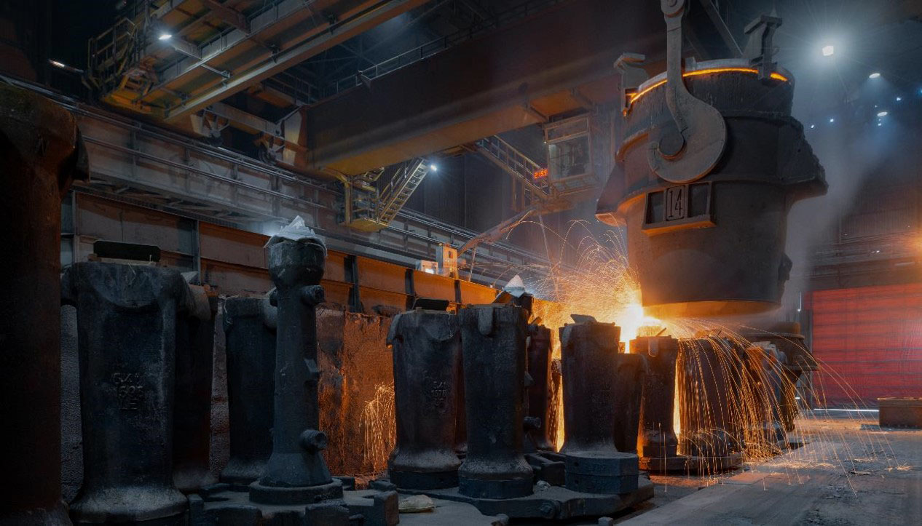

LIBERTY OSTRAVA Restructuring Plan Presentation
Executive Committee
^{14th} March 2024

Slide 2

Executive Summary
The Presentation
The presentation today will be presented by the Liberty Ostrava Board of Directors and the CEO of Europe Upstream
Iain Hunter – Director
Deepak Sogani – Director
Ajay Aggarwal – Chairman of the Board
Theuns Victor – CEO of Europe Upstream
The presentation will take about 30 min and will be supported by Slides
There will be portal available that will allow you to post your questions and we will ensure that it gets answered as soon as we can.
This presentation will be kept on this link should you want to review at a later stage again
The presentation will also be made available with subtitles in Czech
The Plan
Presented by the Directors

Slide 3
Executive Summary
The Restructuring Plan
Will create a sustainable future for LIBERTY Ostrava and all its stakeholders
Will use our own Blast Furnace and Meltshop to make slabs and billets
Will use our own Rolling Mills to convert the slabs and billets into high value finished product for our customers.
Our plan will see our Creditors being paid back in full
The plan relies on significant Group contribution to support the recovery plan.
The Restructuring Plan includes two options
one which includes a solution with Tameh – Our Preference
one without Tameh – Currently looking more likely
Both plans have largely the same underlying production assumptions but are phased differently (see later).
The Plan
The key outcomes

Slide 4
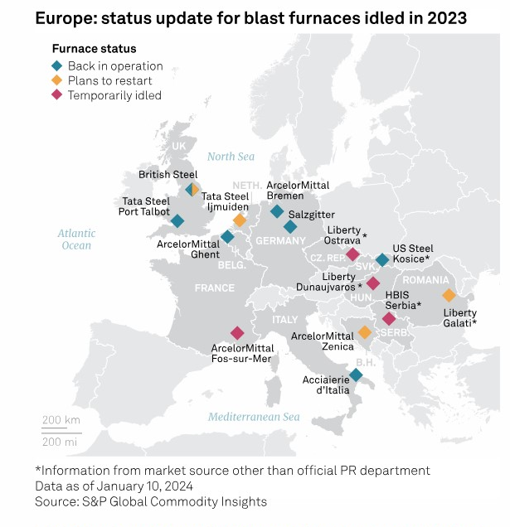
Executive Summary
The Steel Market in Europe
The Steel Markets across Europe has seen the worst times since the Global Financial Crises in 2008*
This reduced, both demand and the prices for our products, forcing us to reduce production volumes and even to stop the plant to reduce losses
Energy prices has increased due to the War, to levels rarely seen before#
The agreement with Tameh, as contracted in 2019 when the plant was running at full capacity, became even more uncompetitive due to the reduced production rates.
* - 2023 has seen a reduction of more than 26mt of steel production from Europe compared to 2021
# - Electricity and Natural gas escalated by 200% between just between Jan 2022 and Apr 2023

Slide 5
Executive Summary
Our Ask from you
We are asking our Creditors to support the following
The exclusion of Tameh from the Plan. – Those that have not voted yet
Agree to the proposed Restructuring Plan, giving LO and its stakeholders another change – the only change.
Our Shareholder has shown his clear support for the plan in the last few weeks.
The Board of Directions, here today, firmly believe it is in the best interests of LIBERTY Ostrava, our creditors, and our stakeholders that you support this plan.
The Plan

Slide 6
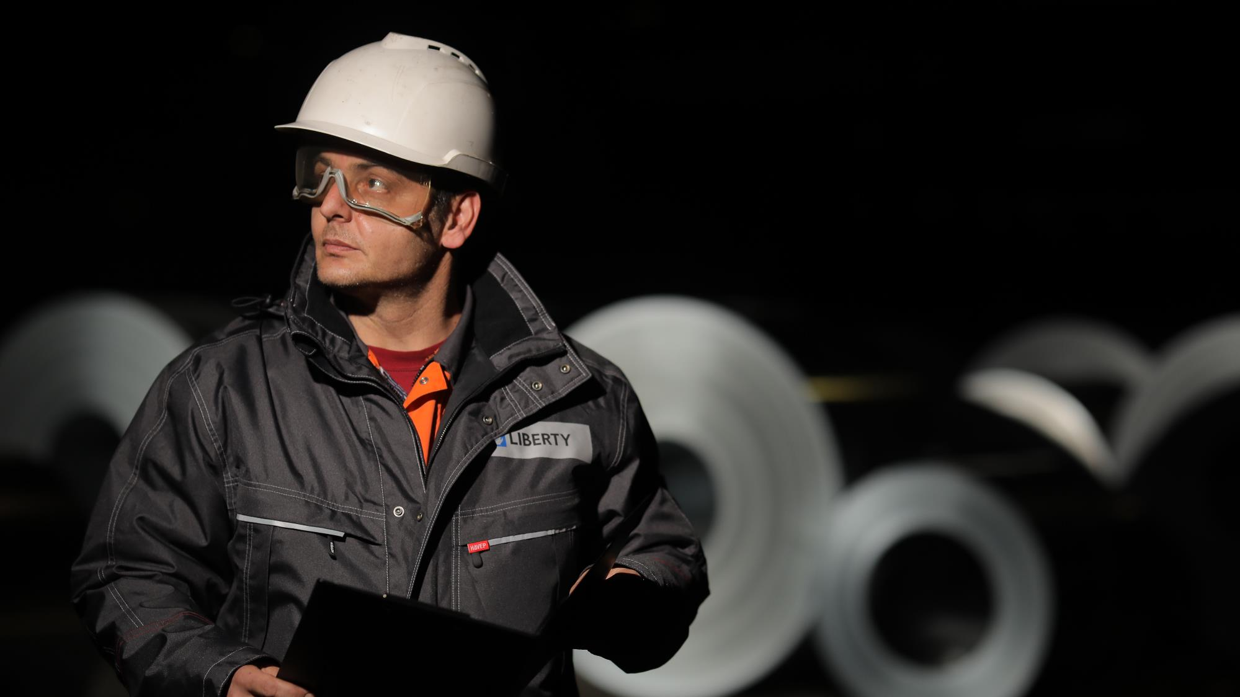
LIBERTY Ostrava
Restructuring Plan

Slide 7
The Plan is based on key principles
The Rolling Mills will be restarted in advance of the Blast Furnace with imported feed (Slabs and Billets) - Target date March 2024
Reduction of overall production through the Blast Furnace (80ktpm) to only produce products with a positive contribution. – Latest restart date of Blast Furnace end of Dec 2024
Reduction in the cost base through efficiency improvements and other cost reductions initiatives – more than Euro 100m per annum
Significant reduction in the cost of energy by restructuring or replacing Tameh – almost Euro 100m per annum
Injecting working capital from Group to support the restart – Euro 160m over the life of the plan having already contributed Euro 20 million in the past weeks
The Plan

Slide 8

Market Assumptions
1
2
3
The commodity prices for the business plan have been sourced from MEPS International, a leading international steel industry consultant, which overlays factors specific to Ostrava.
The prices have also been cross verified with forecasts from CRU Group (a commodity business intelligence firm).
The management views these forecasts as aligned to the market intelligence received from customers and suppliers.

Slide 9
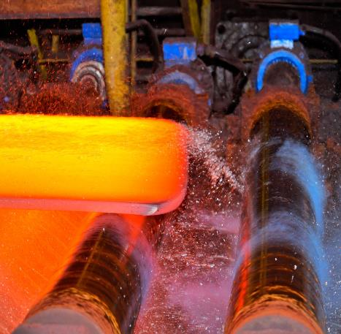
Initial restart of Rolling Mills
An integral part of both plans
LIBERTY Ostrava has already received the first parcel of 5,000t of imported feed as a trial batch and successfully rolled that last week. This material HRC has all been sold and already dispatch to the customer
This will provide some profit contribution until the Blast furnace restarts – Aim is to achieve 80,000t of imported feed through the Steckel Mill as well as the Tubular and Welding Shop
Based on the successful trial the next batches of material will be sourced in the coming weeks with the aim of rolling 30,000t in April and building up to 80,000t in June.

Slide 10
Energy & Other Utilities:
The Restructuring Plan
Plan A – With Tameh
Plan B –New Energy Complex
Total Utilities provided by Tameh as per the requested volume:
Steam
Heating
Compressed Air
Electricity as per the requested quantity
Additional electricity from the National Grid
New Energy Complex:
Package Boilers
Smaller Air Compressors
Electric Blowers
Heating from Veolia
All electricity from the national grid

Slide 11
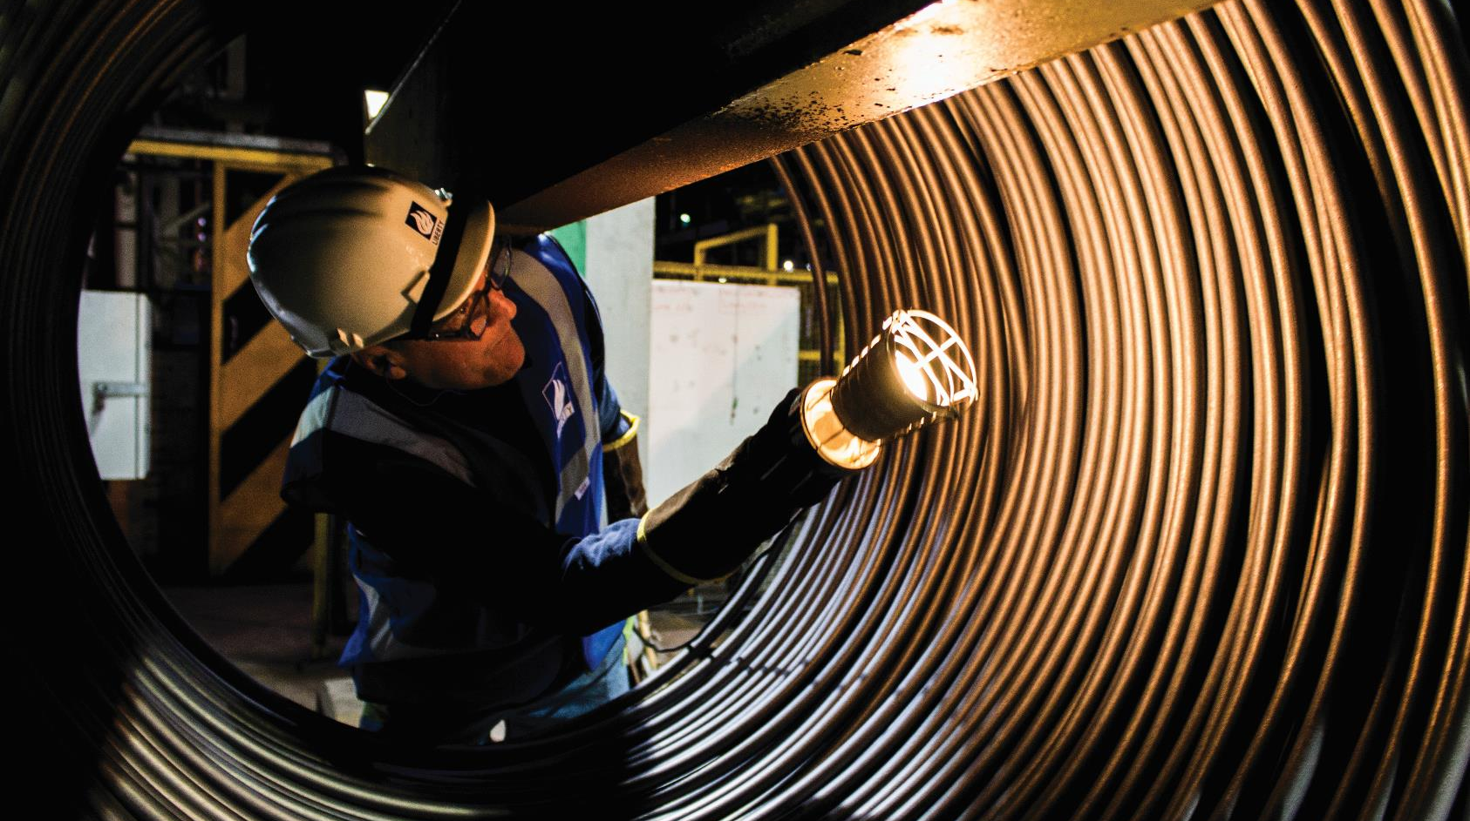
Plan A

Slide 12

Plan A – Overview
- Assumes that there is an agreement reached with Tameh by latest 30 April 2024.
- Under this scenario we will restart the Blast Furnace and facilities in June 2024, ramping up production gradually by July.
Plan A
For Plan A to succeed, the business will need to seek an initial payment holiday from Creditors as follows:
Ensure 25% of dues are cleared before 30 June 2024
Balance of 75% to be cleared between Jan 2025 – Mar 2026

Slide 13
Plan A - Key Assumptions
- Agreement reached with Tameh before 30 April 2024.
- Rolling mills will roll a further parcel of 30kt in the month of April to support the ongoing cost. These slabs will be sourced either from Galati or external.
Plan A
- Agreement is reached with all key Creditor classes including EGAP.
- The restart of the Blast Furnaces is planned for June 2024 with full and stable production achieved in July 2024.
- The restructuring plan will rely on cash injection from Group of EUR 160 million.

Slide 14
Plan A financials
Blast Furnace Restart in June with normal production in July
Shipments of finished goods from own slabs
The first tranche of overdue payments
Remaining payments of outstanding debt
Group support for the period June onwards Euro 115m. (Euro 45m before June

Slide 15
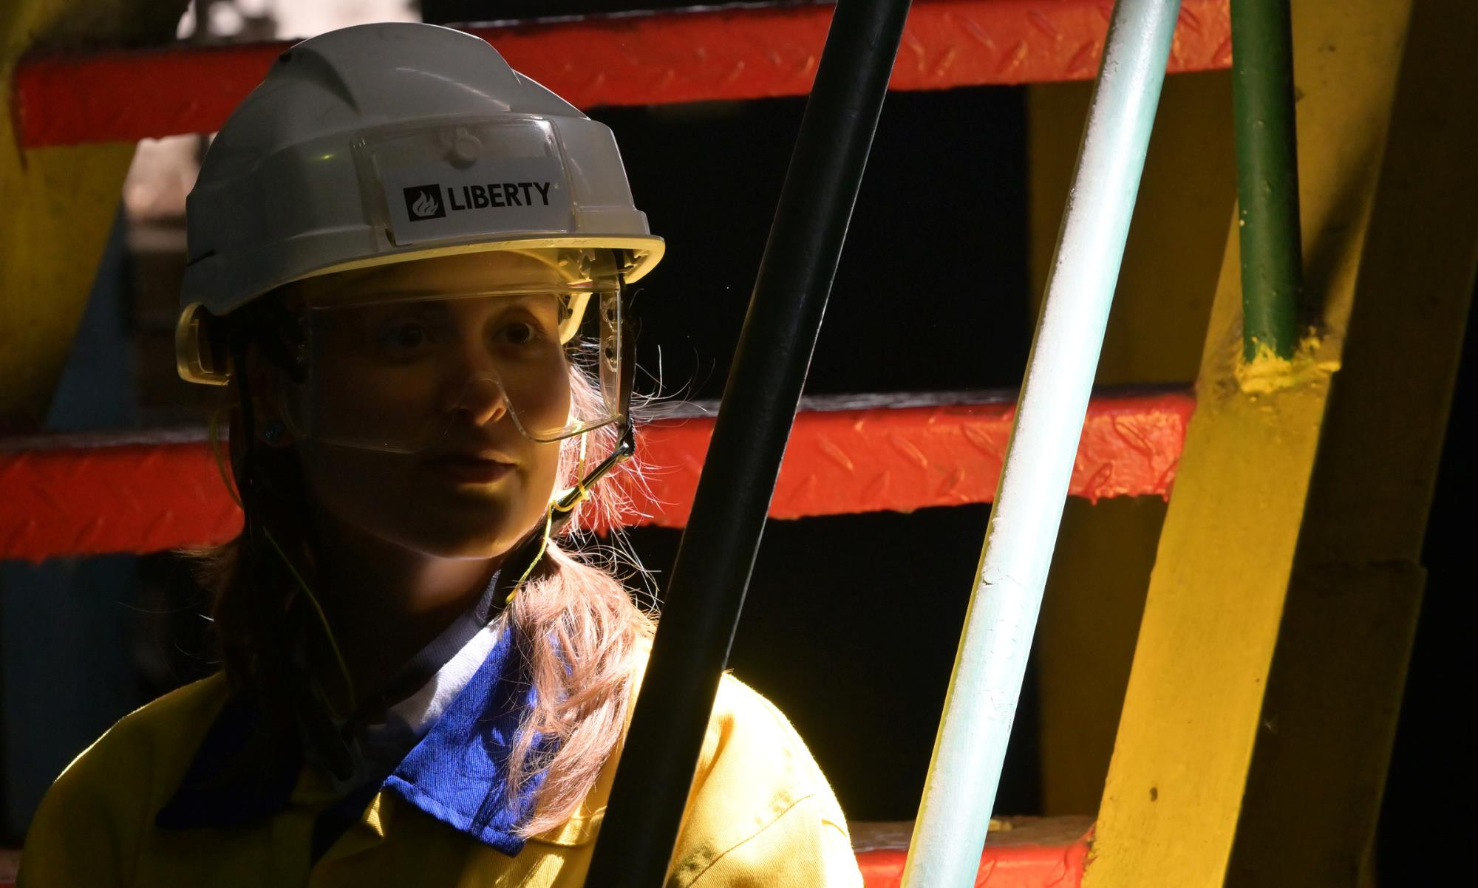
Restructuring Plan B – New Energy Complex

Slide 16
Plan B - Overview
- Assumes no agreement with Tameh for the provision of utilities with the exception of energy distribution.
The purchasing of imported raw material to commence the rolling mills. This will continue to ramp up to 80Kt before the transition to own produced slabs by 31 December 2024.
The target date for the restart of the BF is before the end of Dec 2024. The Blast Furnace and other equipment will be provided with the required utilities from the newly installed equipment
Plan B
The new Electric Blower solution has been developed over the last number of months in parallel with the Tameh discussion:
We have already received OEM (Original Equipment Manufacturer) quotes based on detail specifications.
Delivery timelines as well as installation and commissioning is planned over an 8month period.
Existing similar machines are also available on the market
The new Energy complex will consist of:
Will start with mobile boilers that will eventually be replaced with permanent Boilers
Will include the Electric Blowers with Motor, gearbox, blower and drive
Smaller air compressors to provide compressed air

Slide 17
Plan B – Key Assumptions
- Fundamentally similar to Plan A – key changes are:
higher initial costs to the plan while the transition project is completed.
longer cash burn rate to the end of 2024.
- Cash requirements peak at €160 million (CAPEX, contingency & higher operating losses) - assumed to be covered by a combination of Group support, working capital and, potentially, fixed asset finance.
- Once the Blast Furnace is up and running, the same operating assumptions continue but 9 months later than Plan A.
Plan B
- Fixed & variable cost base is significantly reduced.
- The Blast Furnace will not operate until the conversion to electric compressors is completed – the assumption is that the Blast Furnace will restart by 31st Dec 2024 and will ramp up by February 2025.
- Under Plan B underlying variable costs of operating once production is full are materially lower, contribution is higher and free cash generation greater .
- Plan B means Creditors repaid in a 9-month period between April – Dec 2025.

Slide 18
Plan B financials
Tameh is discontinued, and Ostrava spends €40mn in capex for its effective replacement.
The benefit of this capex is cost reduction of c. €45mn per annum.
The BF restarts in Jan’25, Inventory finance of €25mn assumed in Jun with the Company purchasing slabs from the market.
Ostrava will repay 25% of its dues to Creditors before 31st Dec’24 and the balance 75% before 31st Dec’25.

Slide 19

Differences to Plan for Creditors

Slide 20


Restructuring Plan – Impact to Creditors
Agreement reached with Tameh
Blast Furnace restart 1 June 2024
Blast Furnace operational mid July 2024
Total restructuring period 24 months
A
Plan A impact on Creditors
No agreement reached with Tameh
Blast Furnace restart 31 Dec 2024
Blast Furnace operational mid Feb 2025
Total restructuring period 21 months
B
Plan B impact on Creditors

Slide 21

Conclusion

Slide 22

Conclusion
LIBERTY Ostrava is an integral part of the socio-economic fabric of the region.
The management and shareholder remain fully committed to ensure its long term and sustainable success.
The shareholder is ensuring Group receivables are being repaid to Ostrava to ensure liquidity and timely payments to employees and vendors.
The management has demonstrated agility to operate a different model that does not require as much electricity. This is a short-term fix and the goal remains to ensure operating the Blast Furnace and all the all the rolling mills.
The proposed restructuring plan offers the only solution which ensures all creditors getting paid in full over time.
Therefore, the only logical option is to:
approve the exclusion of Tameh from voting on the Restructuring Plan; and
once you have reviewed it, agree to the Restructuring Plan no later than 15 April 2024
Conclusion

Slide 23
For further information, please contact:
creditorsinfo.ostrava@libertysteelgroup.com

